Slide 1
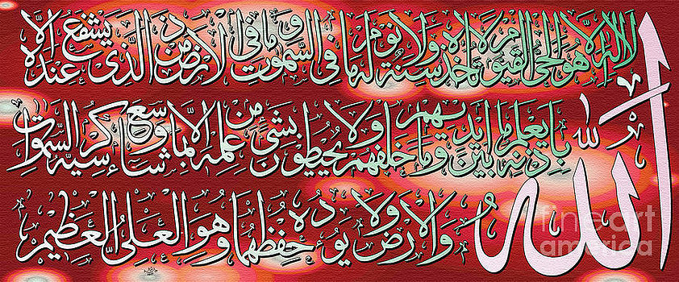
Arabic Calligraphy Elective 2015-2016

Slide 2
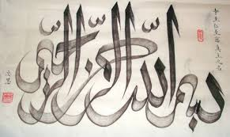
Bismillah Calligraphy

Slide 3
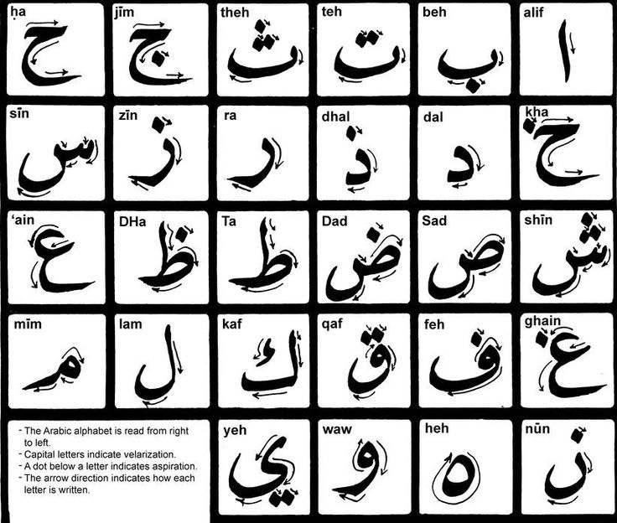
Shapes #1

Slide 4
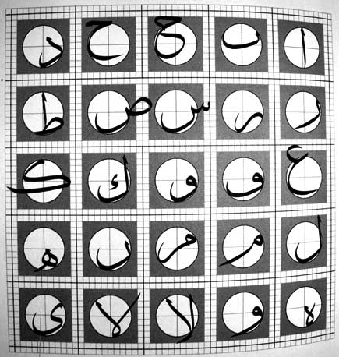

Slide 5
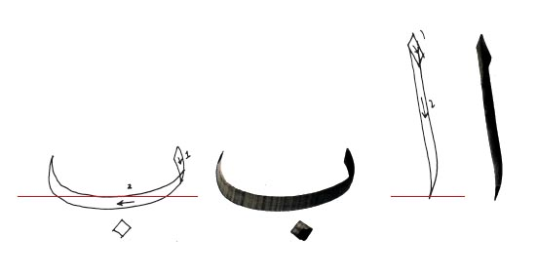
Calligraphy basics

Slide 6
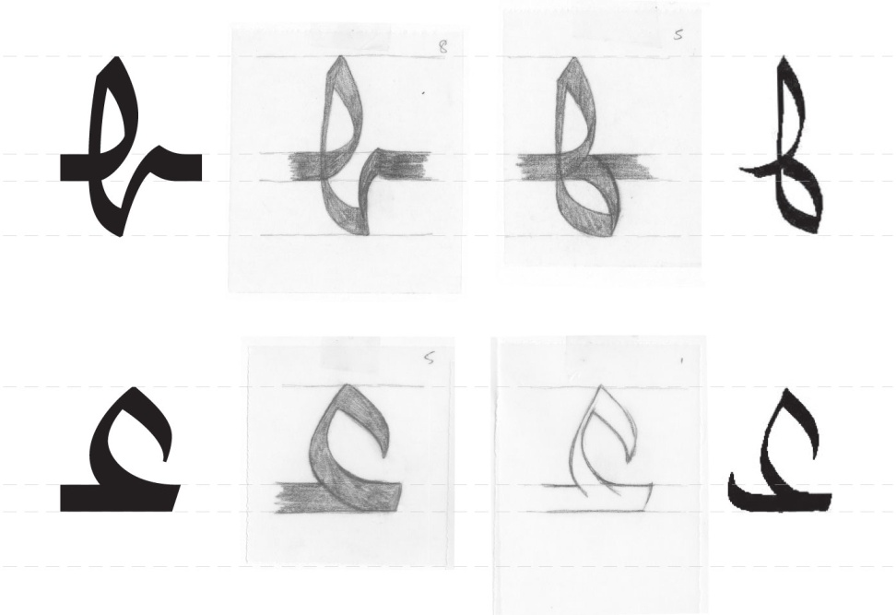
Arabic Calligraphy Fonts

Slide 7
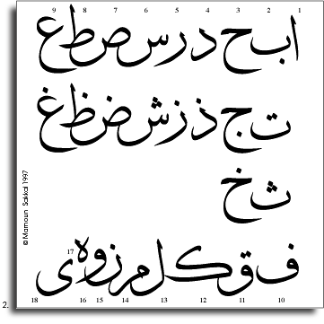
Arabic Calligraphy Font Designs

Slide 8


Calligraphy Designs #1

Slide 9


Calligraphy Designs #2

Slide 10


Calligraphy Designs#3

Slide 11


Calligraphy designs #4

Slide 12


Calligraphy designs #1

Slide 13


Calligraphy designs#2

Slide 14


Calligraphy designs#3

Slide 15


Calligraphy designs#4

Slide 16


Calligraphy designs#6

Slide 17


Calligraphy designs#7

Slide 18
Calligraphy Tutorials
https://www.youtube.com/watch?v=RsOPR4OAQlo

